Slide 1

GEM
«Another way of drinking»
Made by: Luca Schäfli
Marc Hochuli
Nico Müller
Notes:
Ein Projekt von: Luca Schäfli
Marc Hochuli
Nico Müller

Slide 2

Content
What is GEM?
Schedule
Design, CAD & mechanical production
Schematics and electrical components
Stepper motors
Software
Gem in action
Conclusion

Slide 3
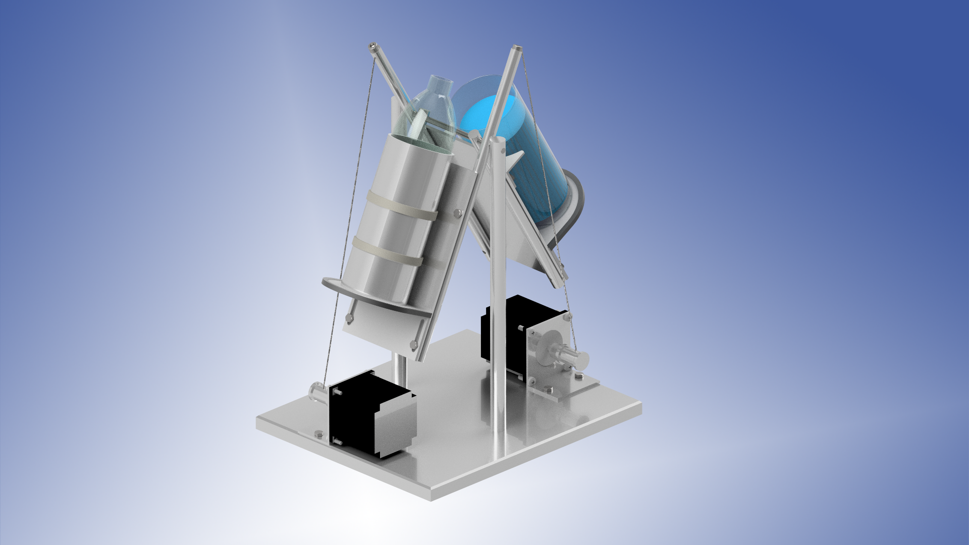
What is GEM?

Slide 4
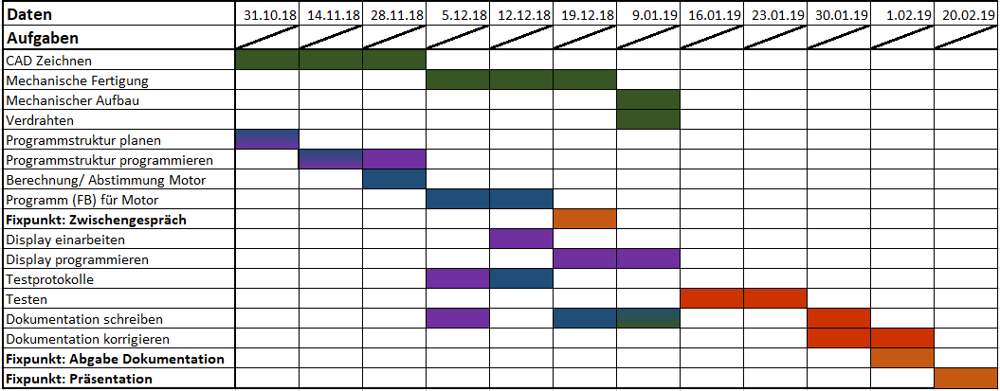
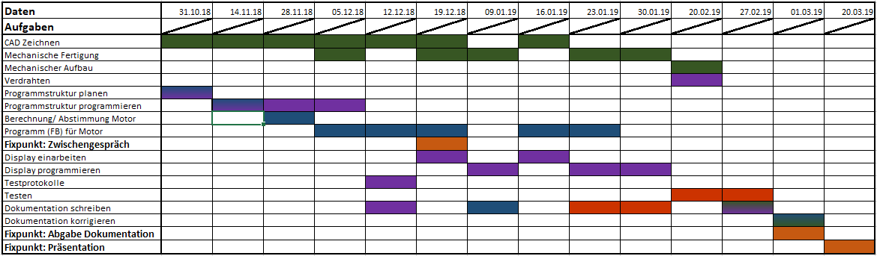
Schedule
Target:
Actual:
Notes:
Acutal:

Slide 5
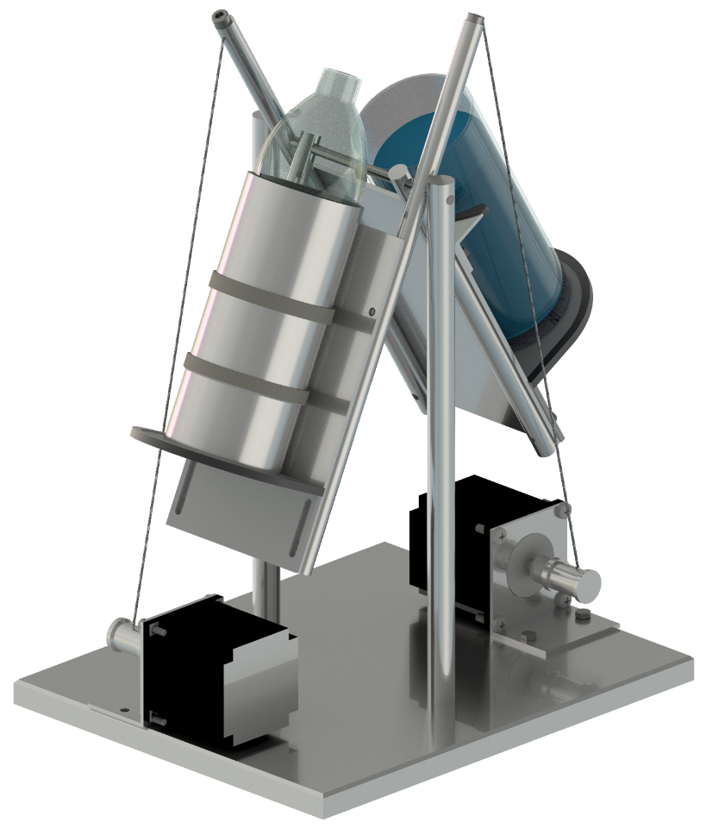

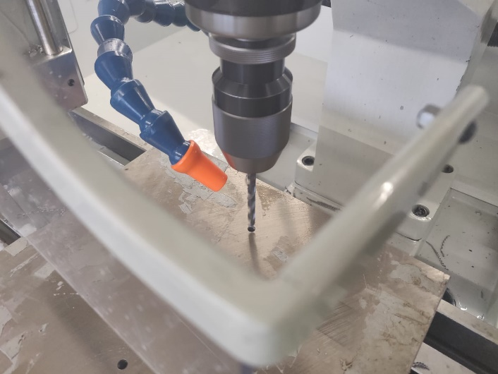
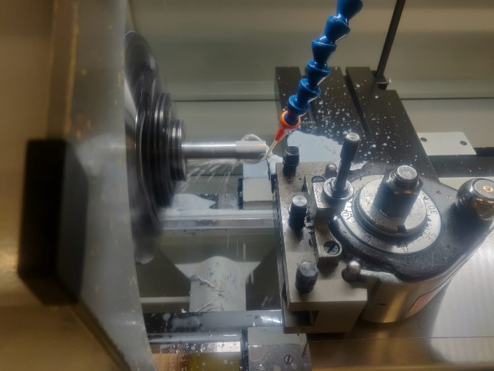
Design, CAD & mechanical components

Slide 6
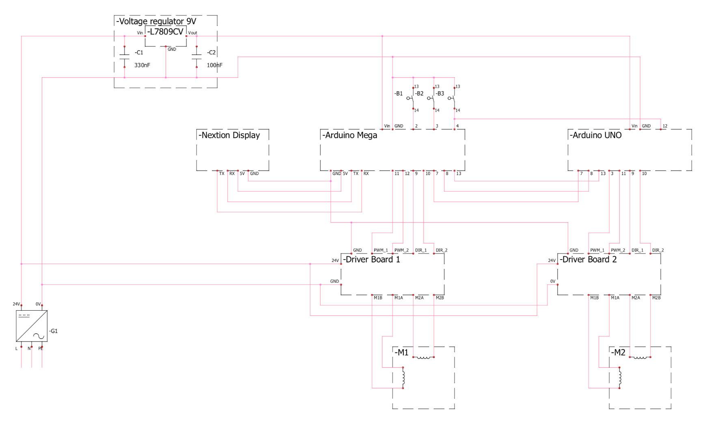
Schematics and electrical components

Slide 7
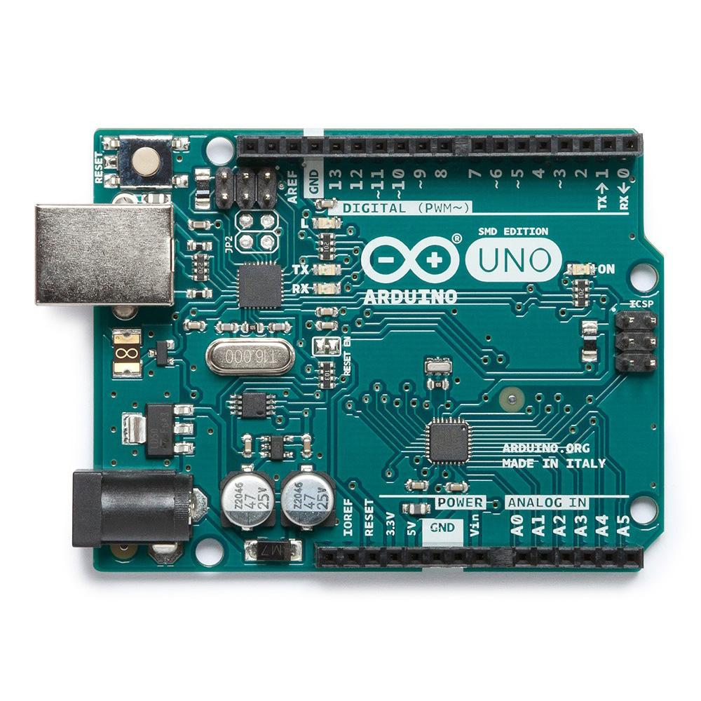
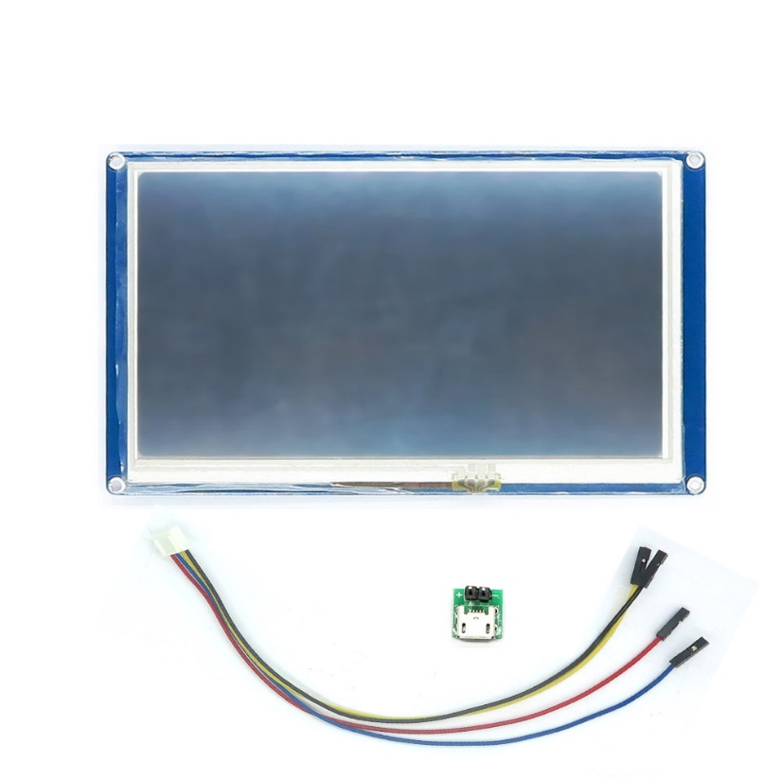
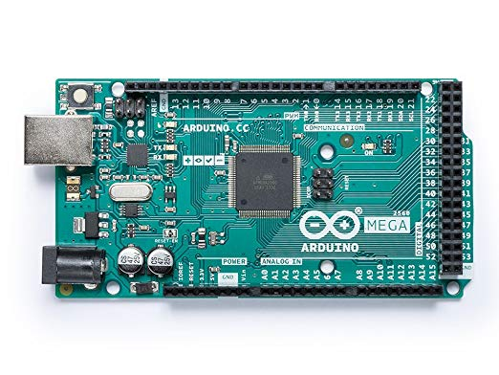
Schematics and electrical components

Slide 8
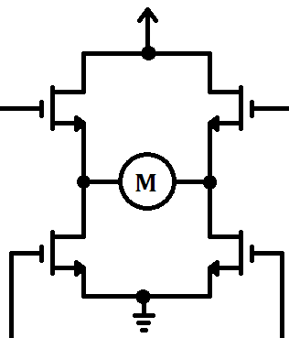
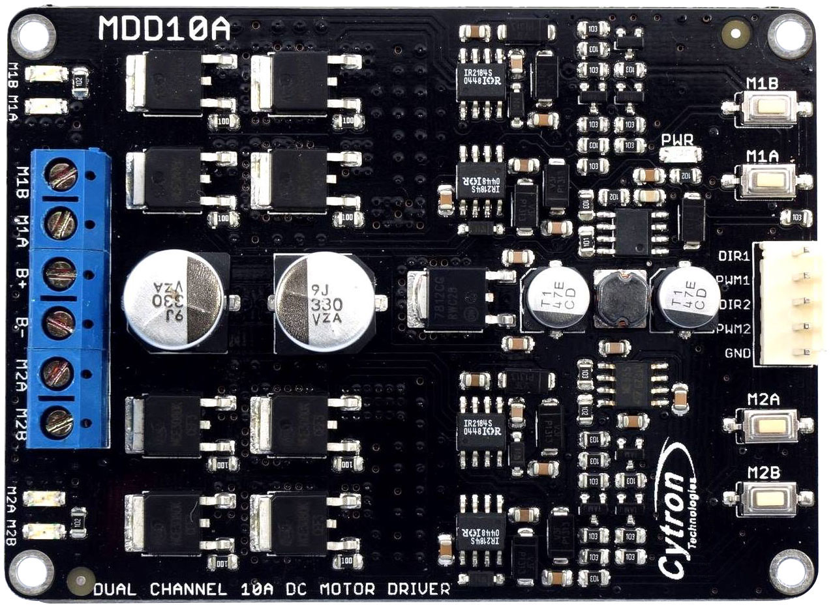
Schematics and electrical components

Slide 9

Stepper motors

Slide 10
Stepper motors
Stator Winding
Winding 1
Winding 2
Magnetic Field
Rotor

Slide 11
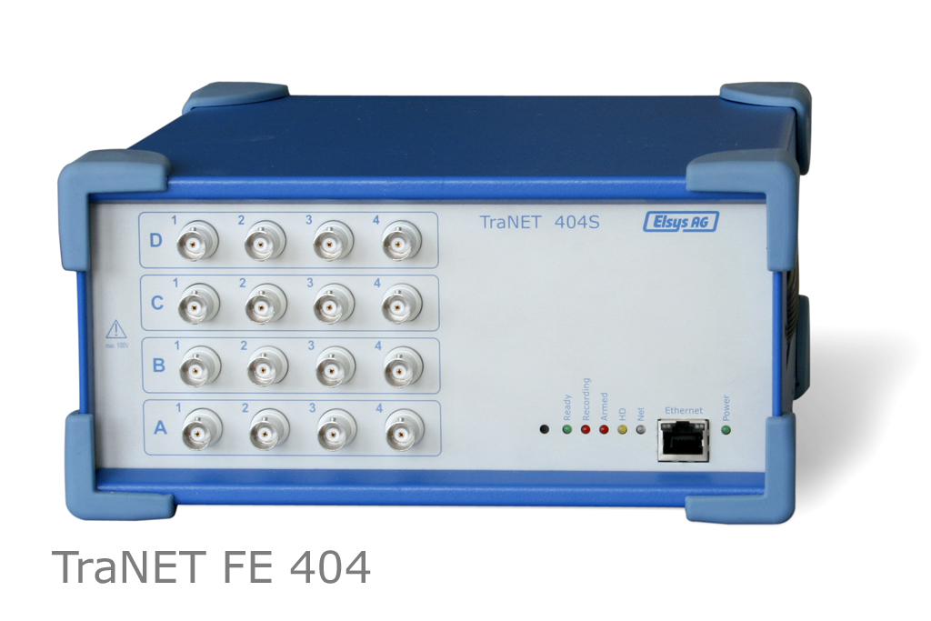
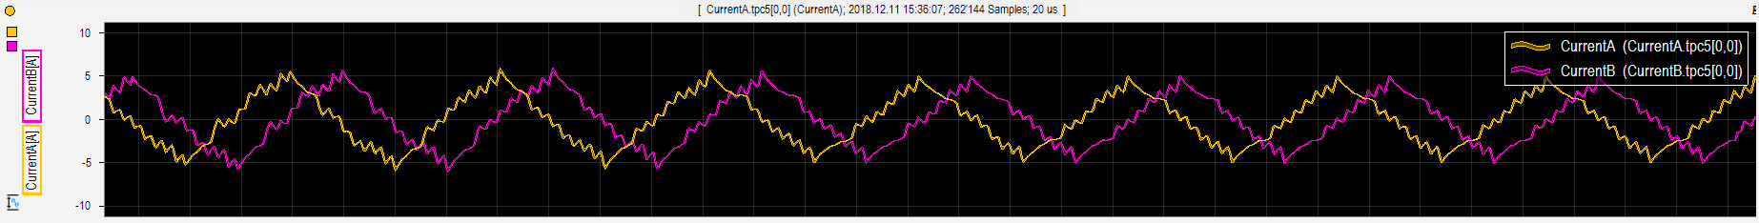
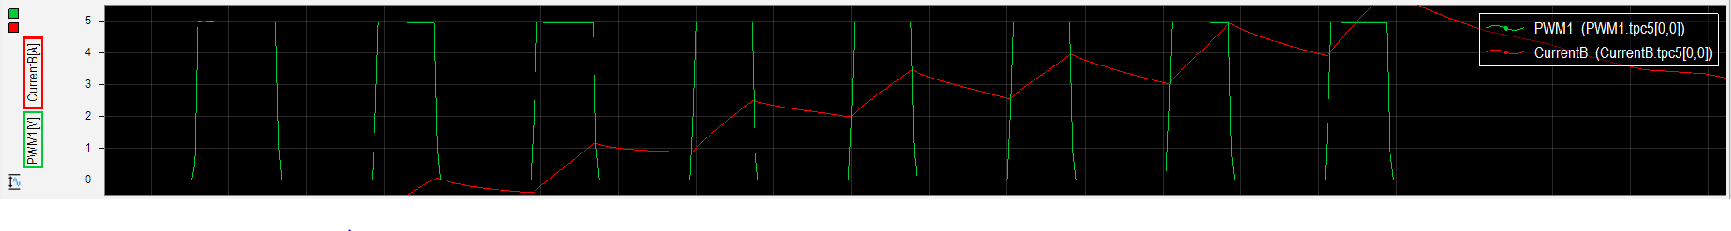
Stepper motors

Slide 12
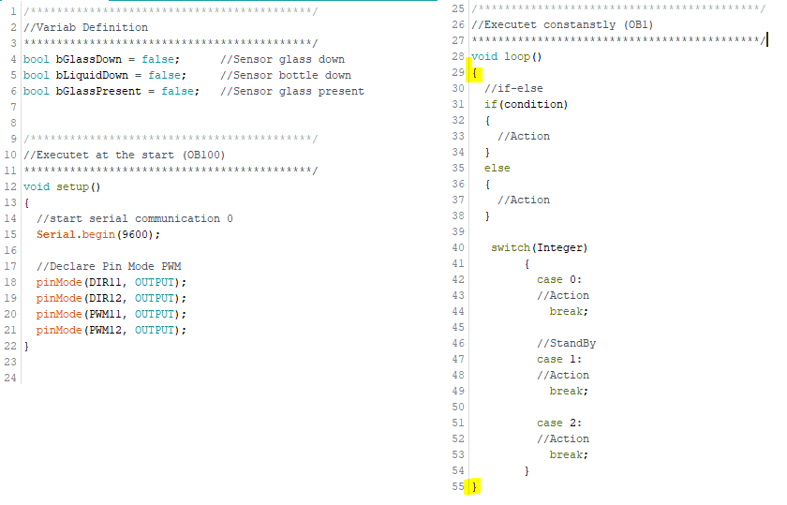
Development Environment
Arduino
Variable definition
Keywords
Void setup
Void loop
Statements
{}

Slide 13
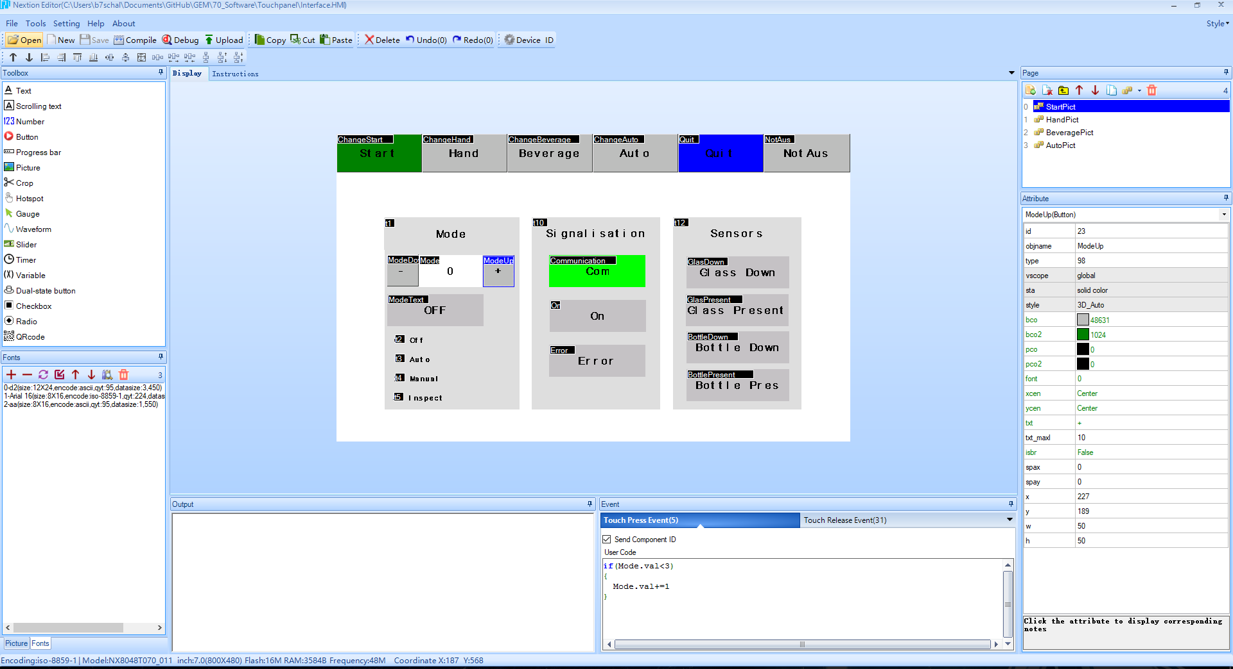
Development Environment
Nextion Editor

Slide 14
Software - Structure
Read Digital Inputs
Read Serial Communication
Update Status
Execute Operating Mode
Movement
Wirte Serial Communication
Write Digital Outputs
Reset HMI Variables

Slide 15
Software - Operating Modes
Operating Mode
Off
Auto
Hand
Insp

Slide 16
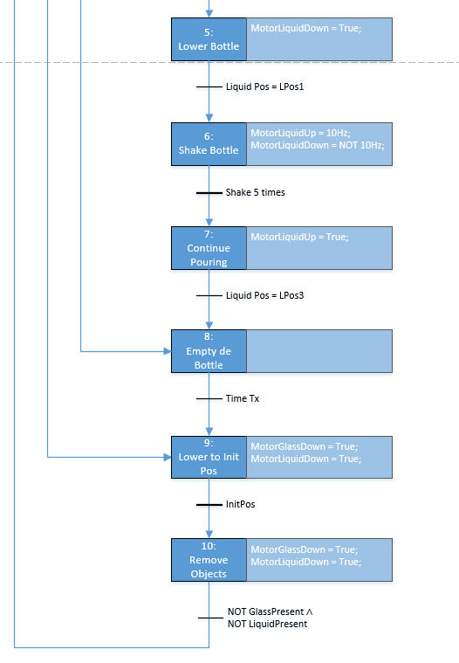
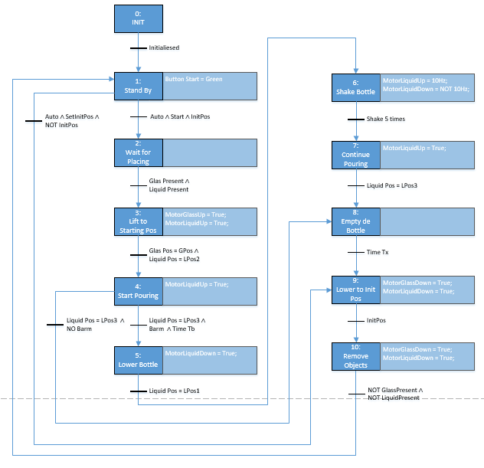
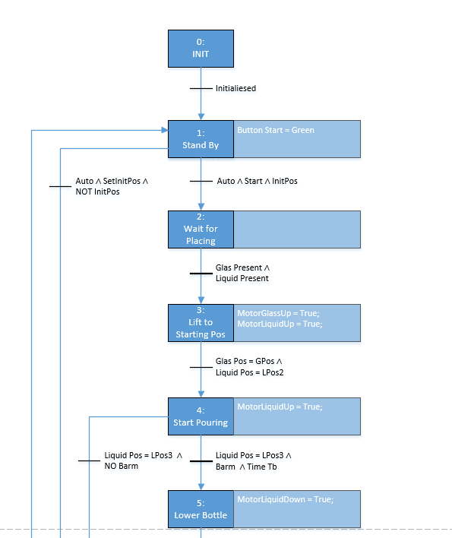
Software – Grafcet

Slide 17
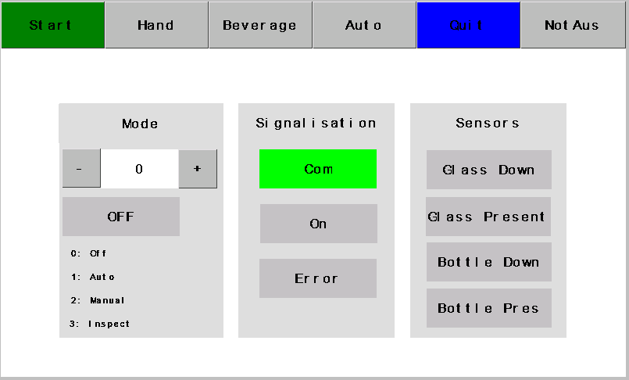
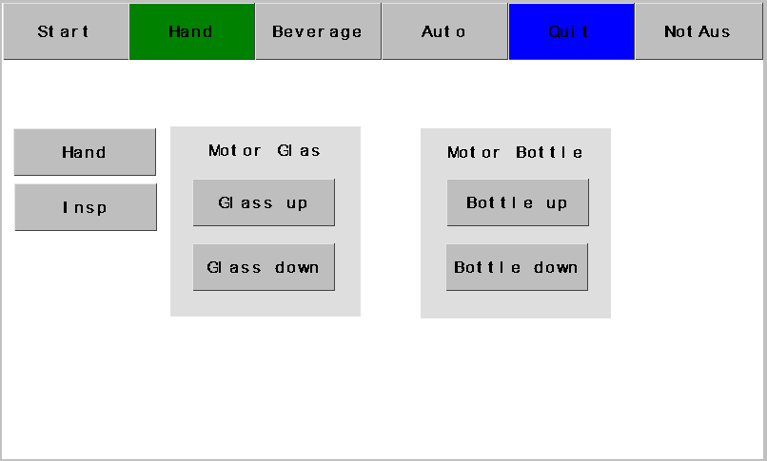
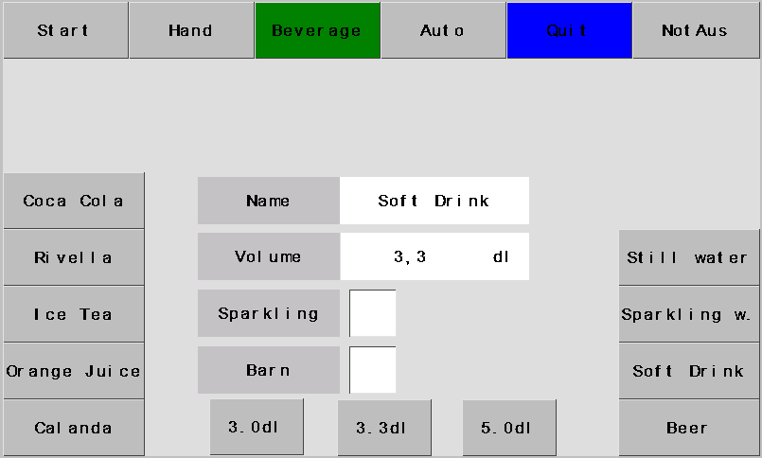
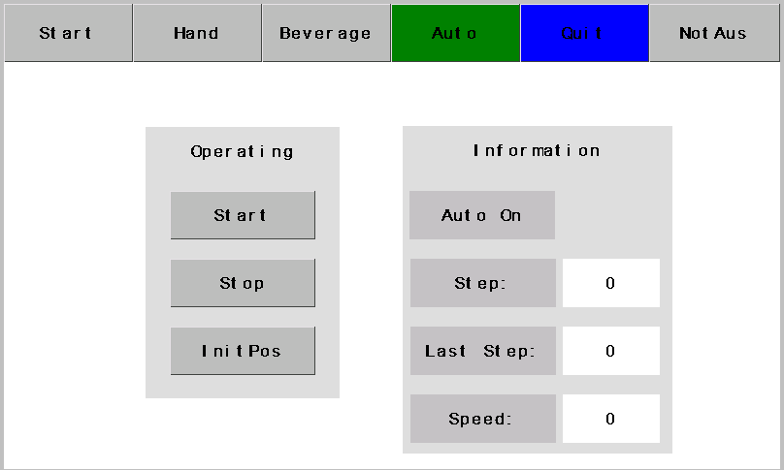
Software - HMI

Slide 18
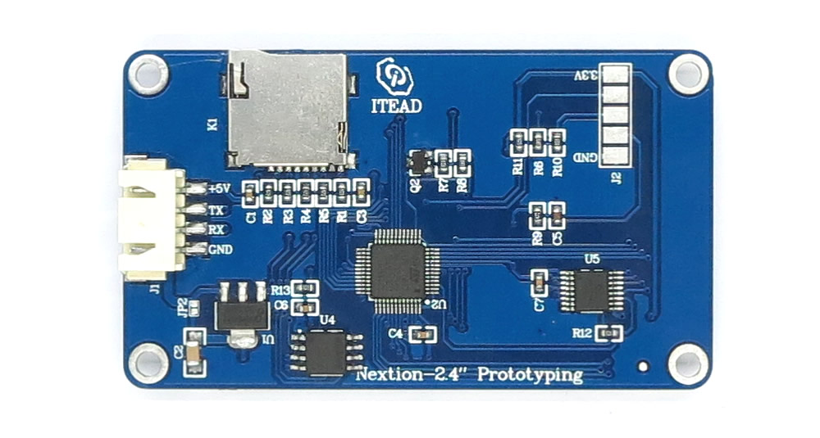
Software - Communication
Arduino Mega Serial Ports
Tx / Rx
Serial Monitor
Serial.println(variable);

Slide 19
Software - Communication
65 02 16 01 FF FF FF
65: Starting Sequence
02: Page number
16: Object ID
01: State of the pushbutton
FF: End Sequence

Slide 20
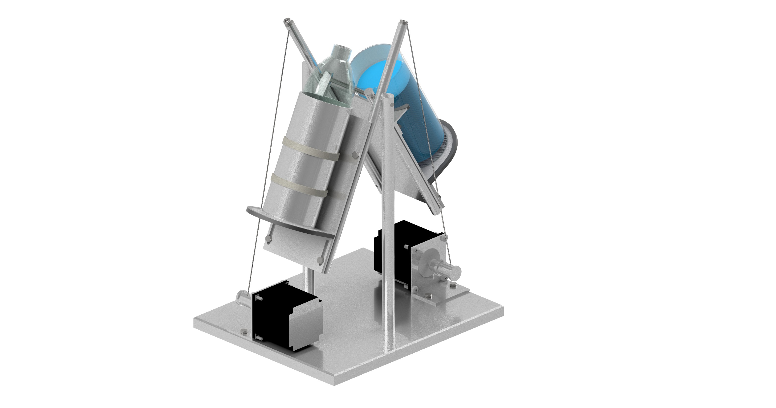
GEM in Action

Slide 21

Conclusion - + / -
+ Achieved our main goals
+ Individuality
+ Research on technical Components
- Minimal signalisation on the Display
- Arduino environment

Slide 22
Conclusion - Improvements
Adjustable speed
Communication
Audibility
Improve adjustable Hight

Slide 23
List of Figures
Arduino Mega: https://images-na.ssl-images-amazon.com/images/I/71WYcNLIVpL._SX522_.jpg
Nextion HMI: https://cdn.itead.cc/media/catalog/product/i/m/im150416002_3.jpg

